Slide 1
Data Structures
Carrano & Henry,
Chps. 10 - 12
Topic 6 – Lists

Slide 2
Lists
A list is a basic way to organize data
To-Do List
Grocery List
Gift list
Items in list have a position (so differs from Bags in this regard)
The position may or may not be important
Items may be added anywhere in the list
And later items will slide over

Slide 3
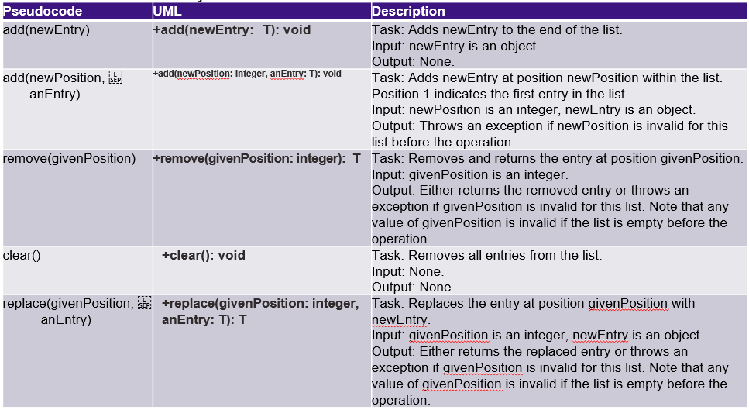
Specification for the ADT List

Slide 4
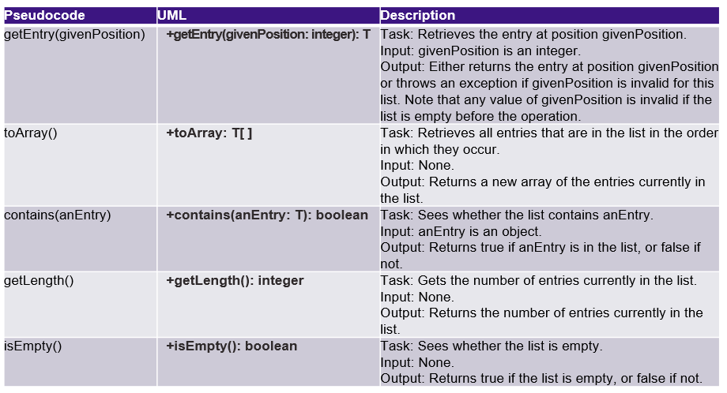
Specification for the ADT List

Slide 5
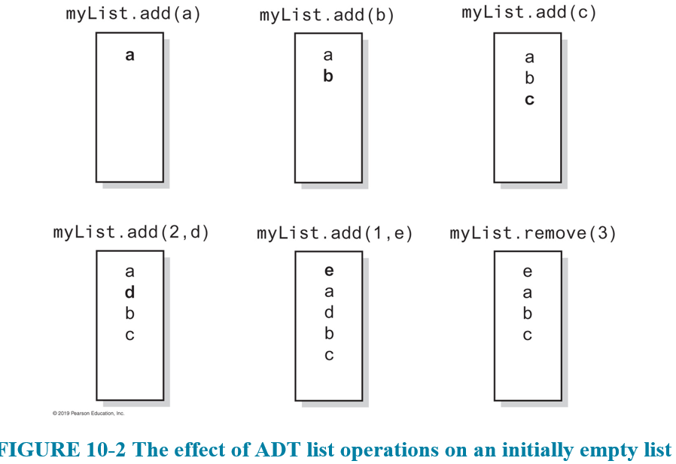
Specification for the ADT List

Slide 6
Implementing the ADT List
ListInterface.java is an implementation of the ADT List
A bit more complex because more operations to support (and multiple versions of some operations)
Operations will throw IndexOutOfBoundsException if provided position is out of range

Slide 7
Using the ADT List
A List can be used to insert entries into it at specific positions
Unlike a queue or a stack, you don't have to pre-process – just place it in the proper place as you add
Example: Entering the results of a race (time trials)
If we enter the results as the competitors post their times, we can add to the List in proper order

Slide 8
The ArrayList Library Class
If you've used ArrayList before, it is a Java library class that is an array-based implementation of the List interface
Similar to Vector (which is also an implementation of the List interface)

Slide 9
The ArrayList Library Class
If you've used ArrayList before, it is a Java library class that is an array-based implementation of the List interface
Similar to Vector (which is also an implementation of the List interface)

Slide 10
Array-Based Implementation
Before using the library class, it is good to look at how such an implementation would be done
AList.java is an array-based implementation of our List ADT

Slide 11
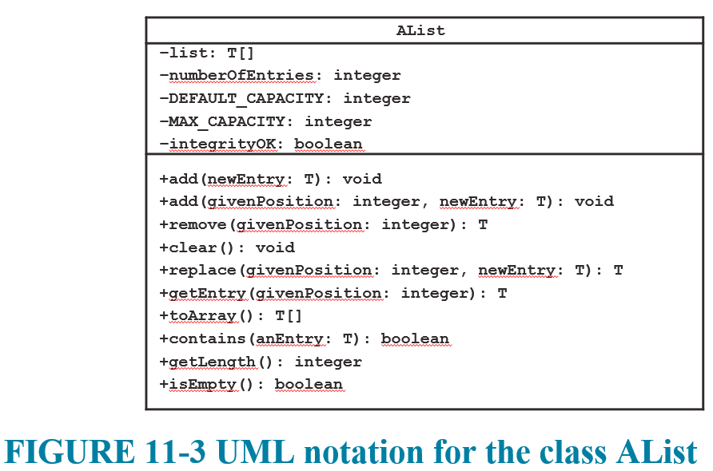
AList Class

Slide 12
AList Class – Adding a New Entry
When adding a new entry at a given index, this will require making room for the new entry
All of the entries from the given index on will have to slide over 1 spot to make room for the new entry
We can loop from the back, until we reach the given index, and copy each entry to the next adjacent spot
We will have to resize, so we can use our ensureCapacity() helper method (but we will resize if we notice adding a new entry made it full)

Slide 13
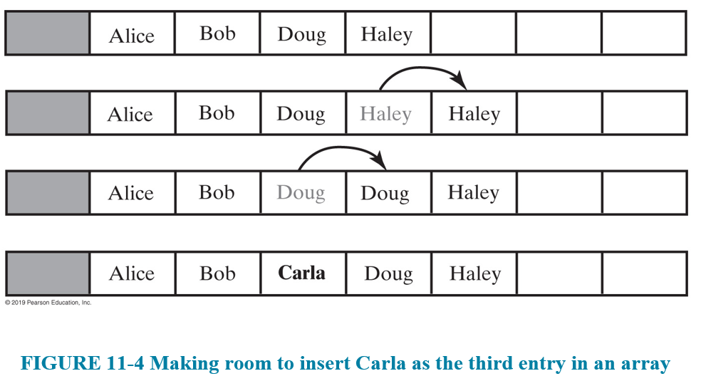
AList Class

Slide 14
AList Class – Removing an Entry
When removing an entry at a given index, we will have to remove the gap that is created by the vacancy
Each element from index + 1 on will have to slide over 1 spot to the left
We use a loop starting from index+1 until the end, copying each entry to the prior adjacent slot

Slide 15
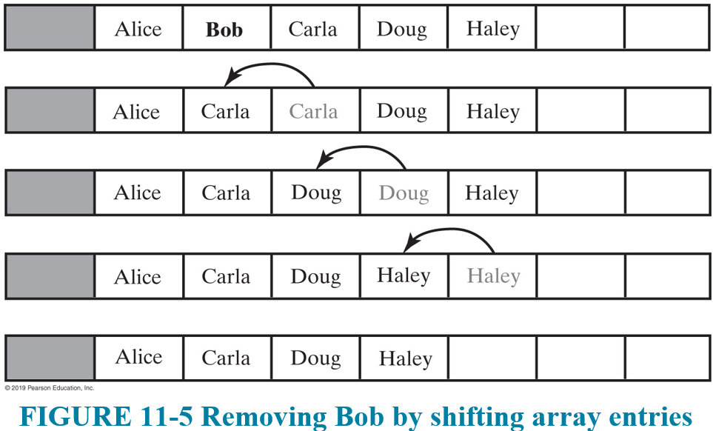
AList Class

Slide 16
Linked List-Based Implementation
Our second implementation will utilize linked lists
Remember:
Linked lists use memory only as needed (nodes will be garbage collected and the memory freed up for the system)
Avoids having to shift entries around (we can just adjust the pointers to insert a new node or splice out a node to be removed)

Slide 17
Linked List-Based Implementation
As we have already seen, there are four possible cases for where a new Node can be added:
To an empty chain
At the beginning of the chain
In between two existing Nodes
At the end of the chain
We saw with the Bag and Stack implementations, that the first two cases are the same (and easiest to do)

Slide 18
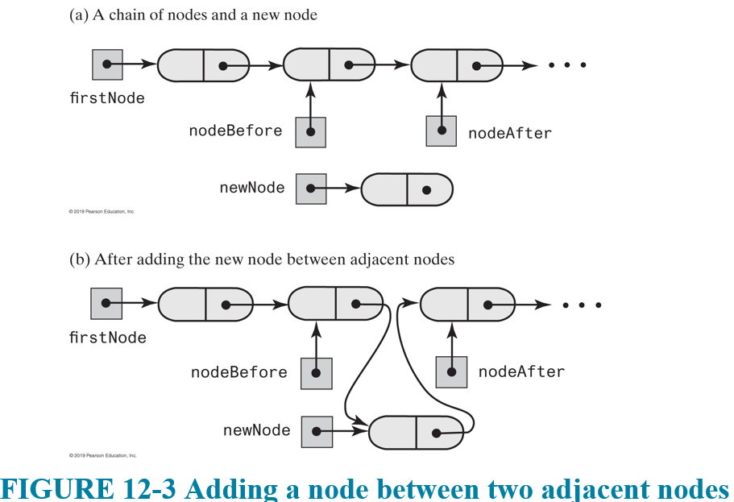
Linked List-Based Implementation
Adding in between two Nodes would be much easier if we had references to both the prior and after Nodes
We can modify our list traversal to track 2 Node pointers to make that possible

Slide 19
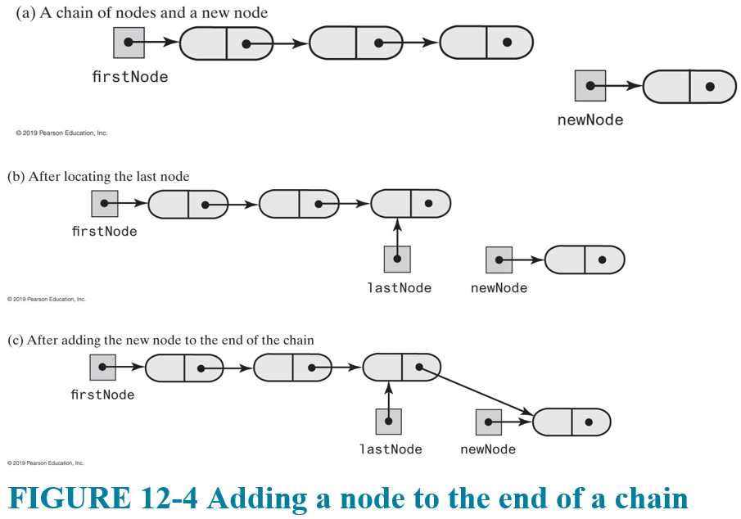
Linked List-Based Implementation
Adding to the back requires traversing to the back Node, but once we have that, it's easy
We can add a reference to the lastNode, but then we have to handle adding to empty as special case

Slide 20
Linked List-Based Implementation
For removing a Node:
Remove the first Node
Remove the only Node (same as above)
Remove any other Node
Again, as we saw from the Bag and Stack, we can easily remove the first (or only) Node

Slide 21
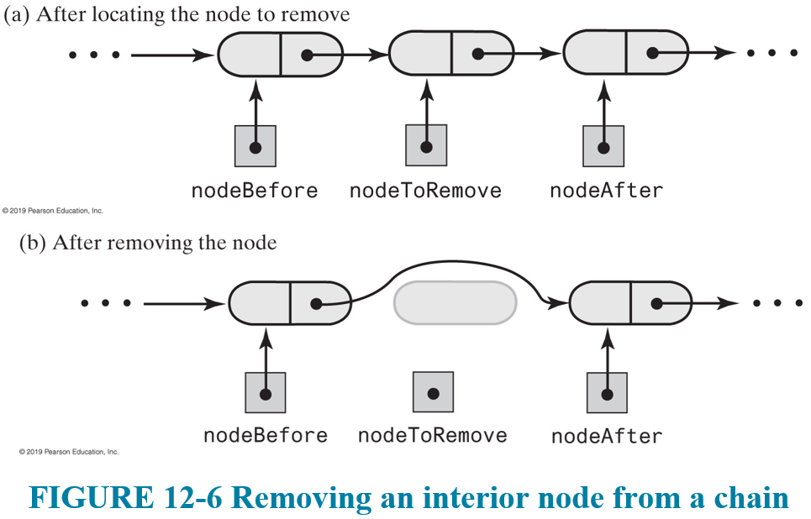
Linked List-Based Implementation
Removing any other Node requires removing the Node before the one to remove (the one after can help as well)

Slide 22
The LinkedList Java Class Library
We can use the built-in library class LinkedList, which implements the interface List
Defines more methods than the interface
Going forward, we can use ArrayList and LinkedList class libraries whenever we need to have a list-based implementation

